Slide 1
Android - Lecture 1

Slide 2
Communication:
deniss.kaibagarovs@gmail.com
Skype: the same

Slide 3
1th lecture Agenda
Introduction to mobile
Android studio overview
Android emulator overview
Android live cycle
Android common elements

Slide 4
Mobile VS Desktop

Slide 5

using device
While walking on the street
Queuing for something
Mostly consuming content

Slide 6
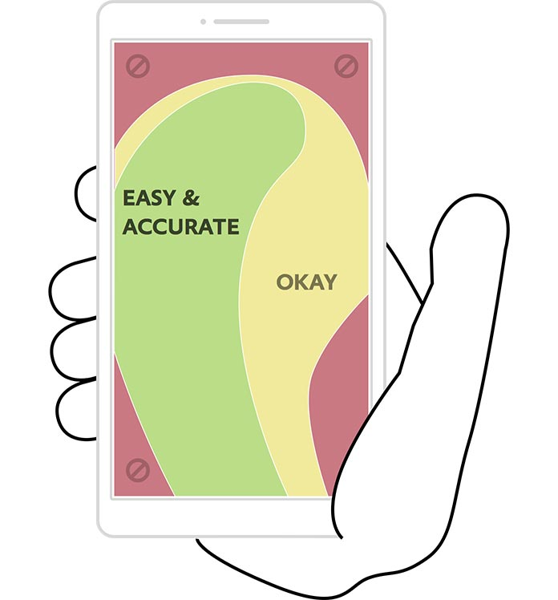
Smaller screen
Touch Input
No hover events
Less precision
Gestures
Tiny keyboard

Slide 7
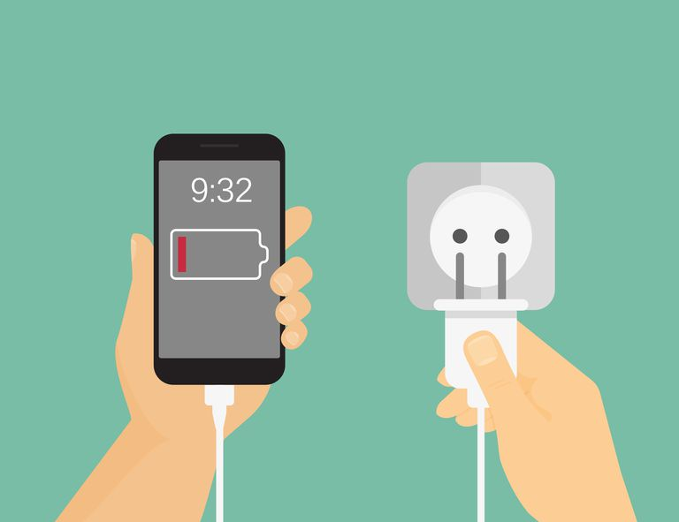
Battery Powered
Developers need to think about battery consumption
Can’t use 100% power of the phone all the time

Slide 8
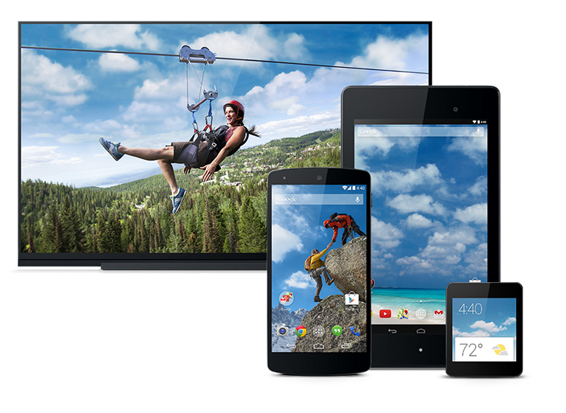
Devices Families
Phones
Tables
TVs
Watches
Cars
Refrigerators
Etc.

Slide 9
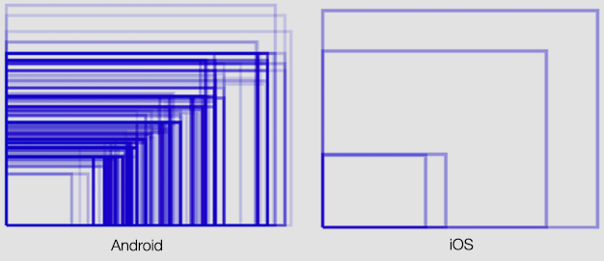
Screen sizes

Slide 10
Where Should I code?

Slide 11
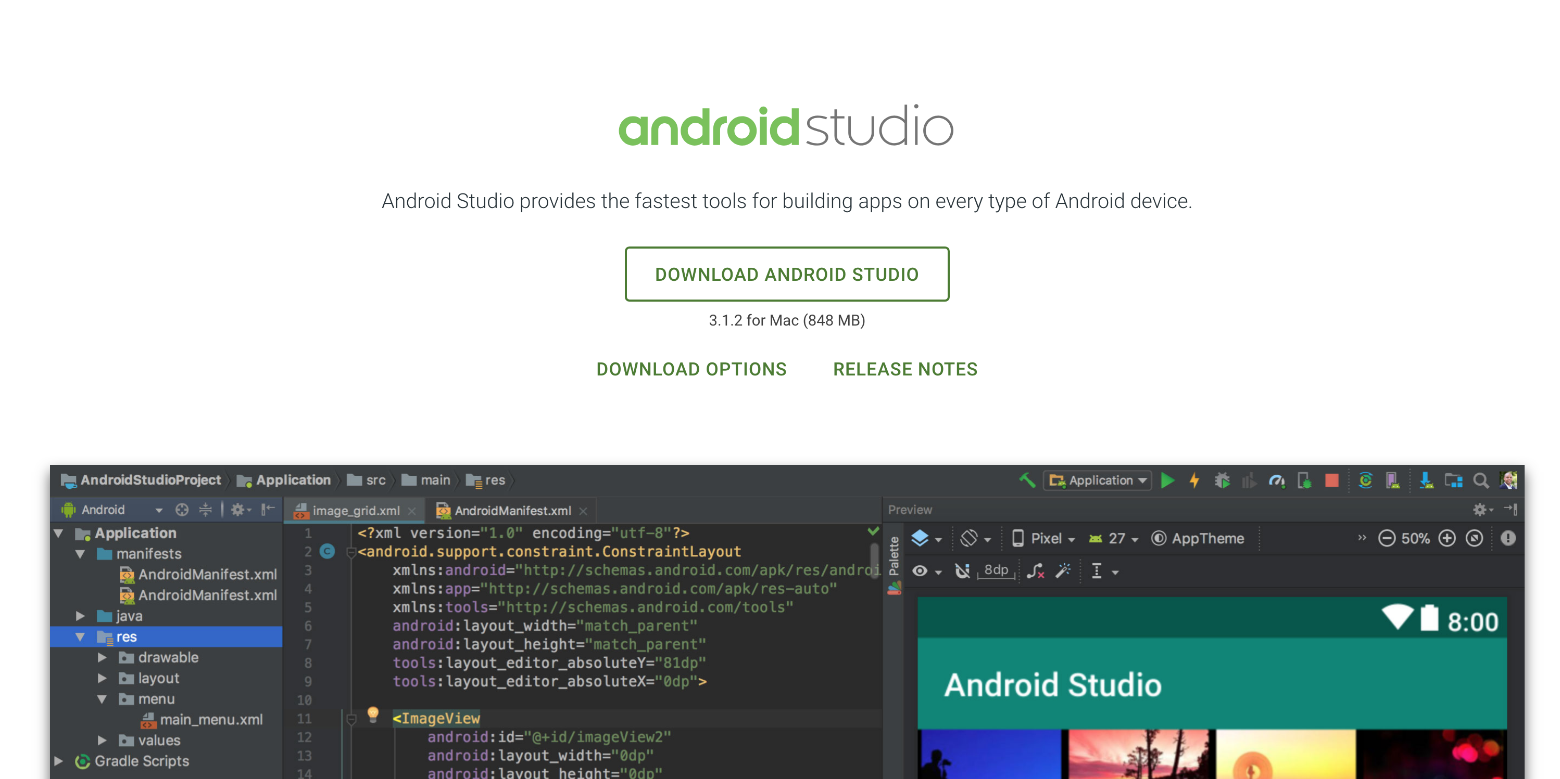

Slide 12
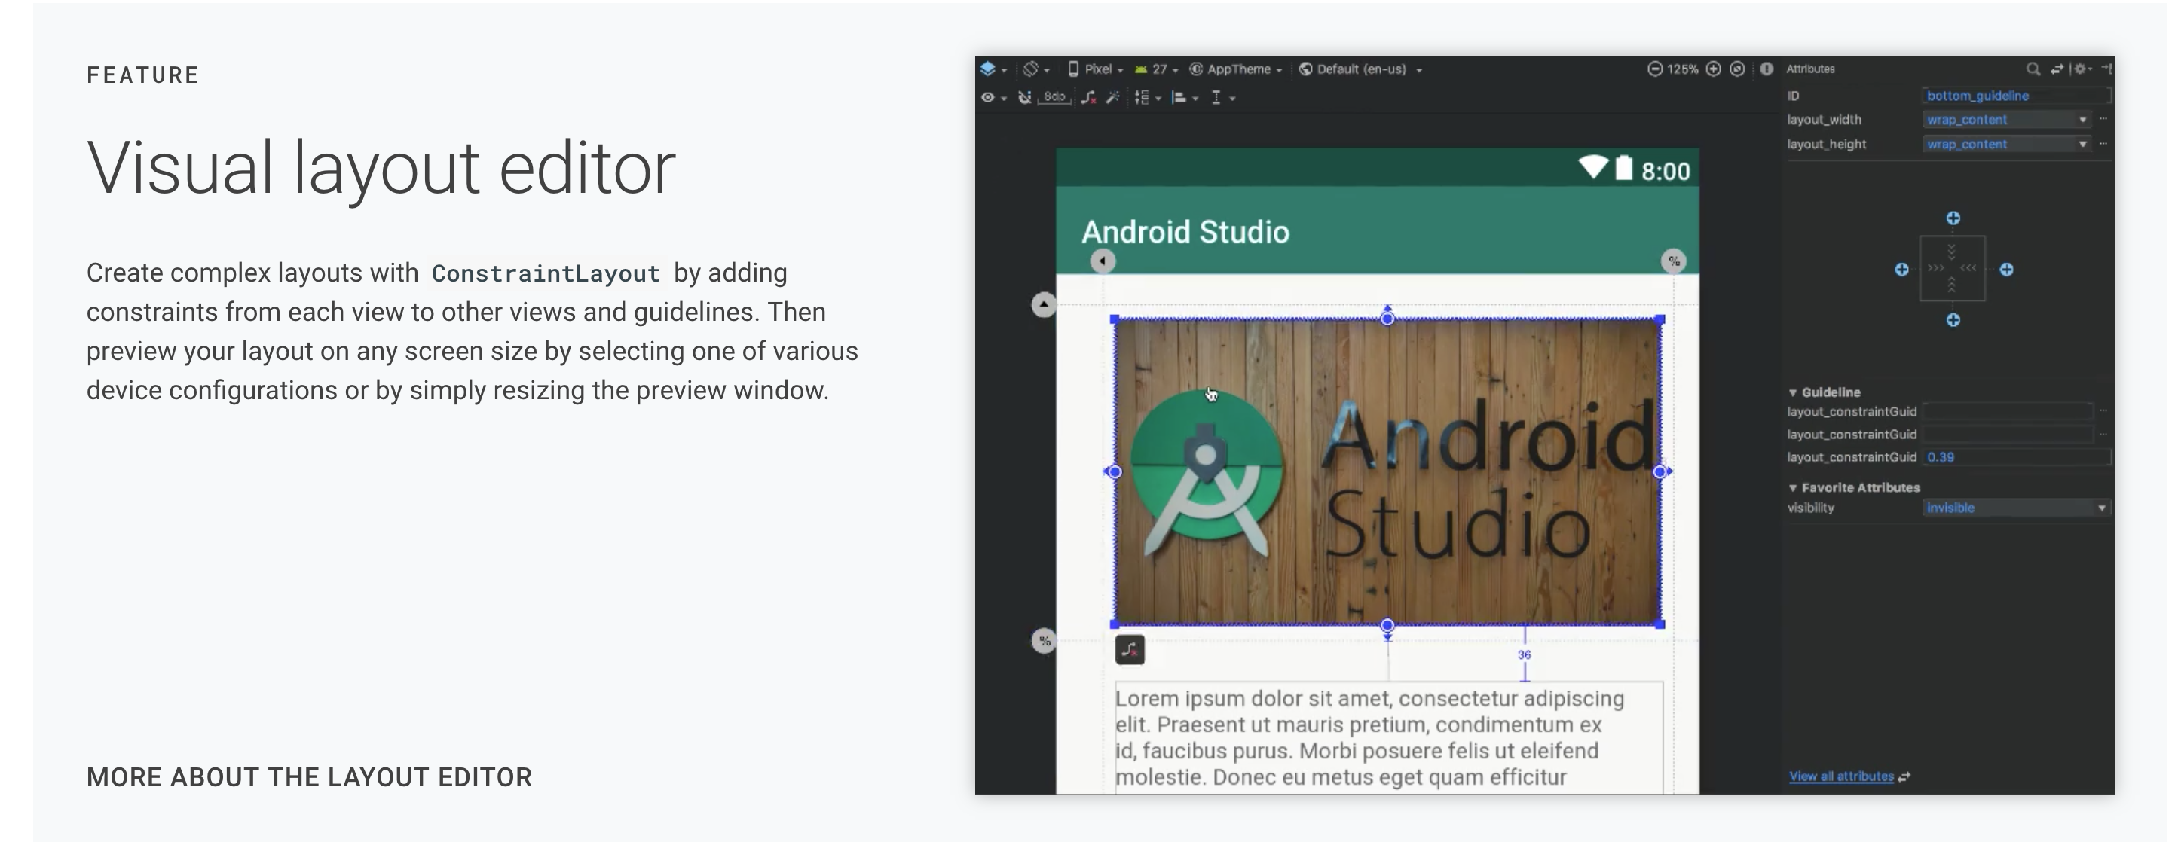

Slide 13
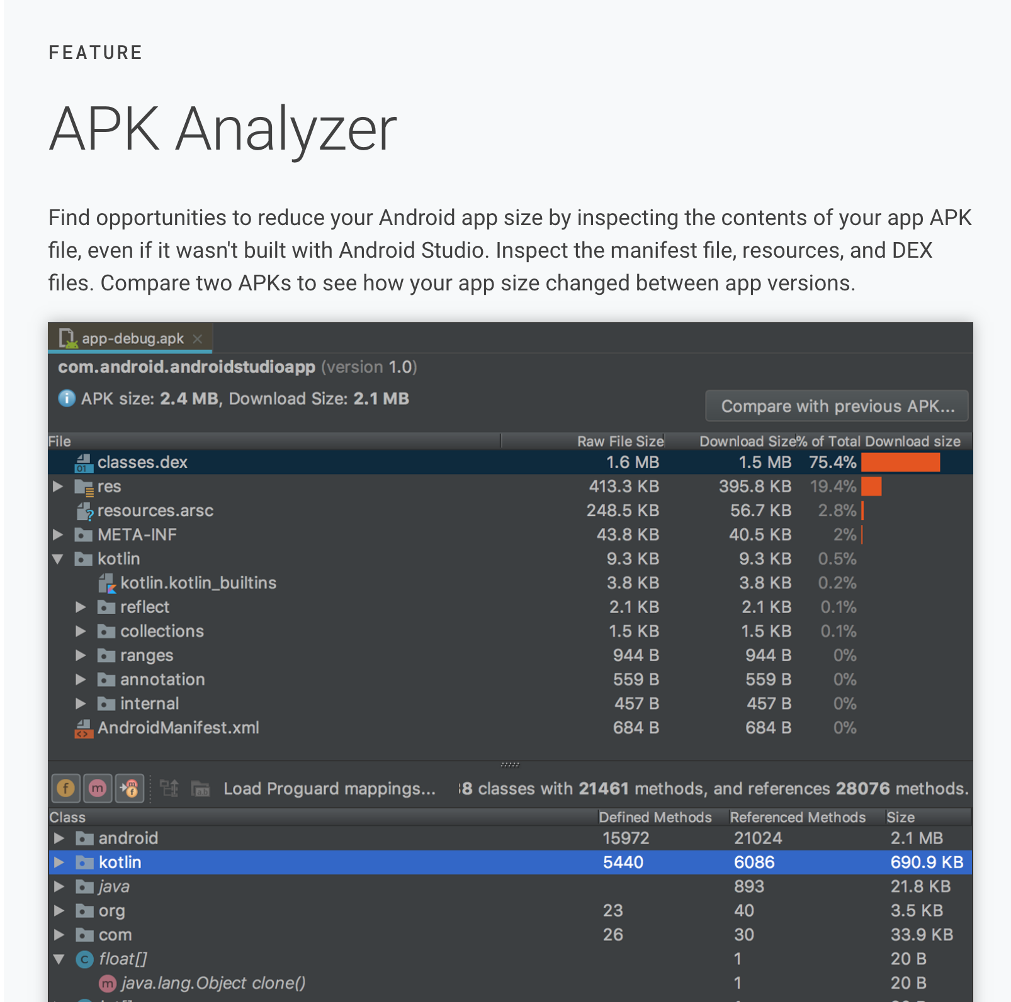

Slide 14
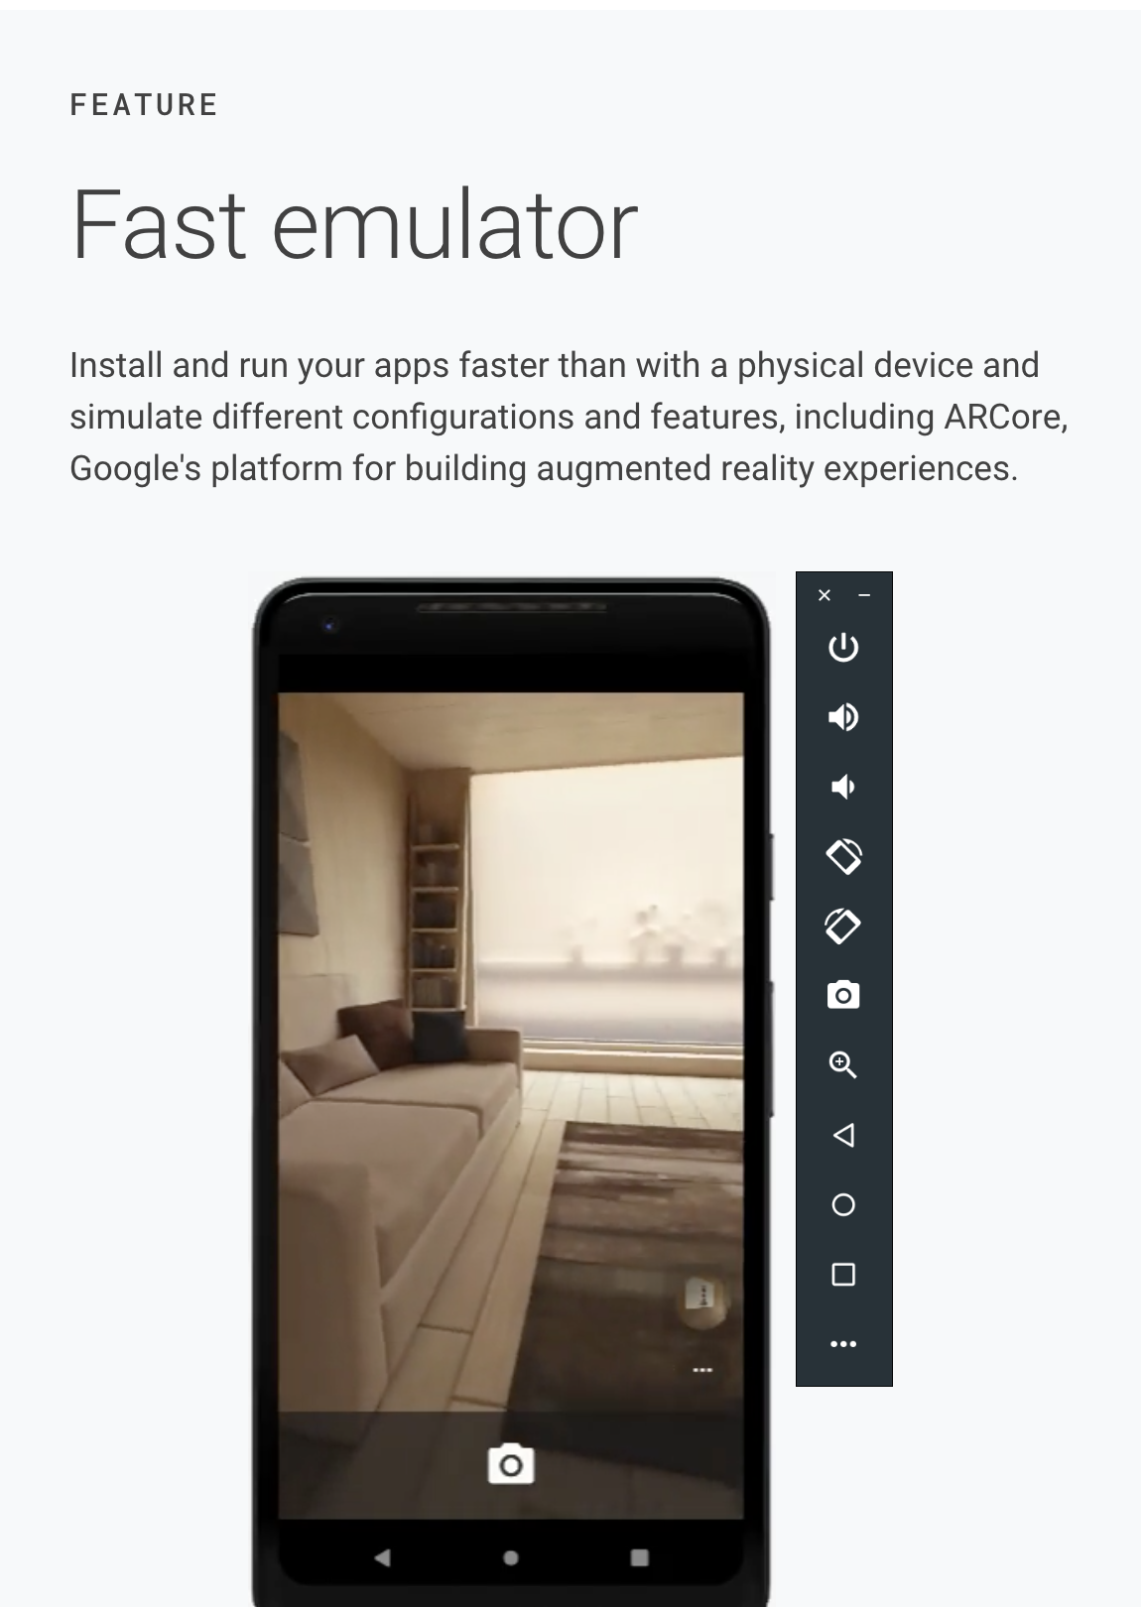

Slide 15
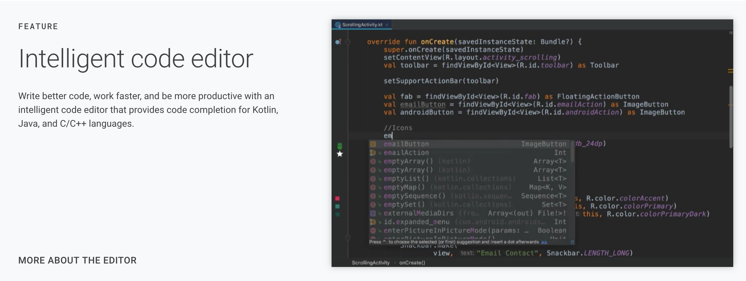

Slide 16
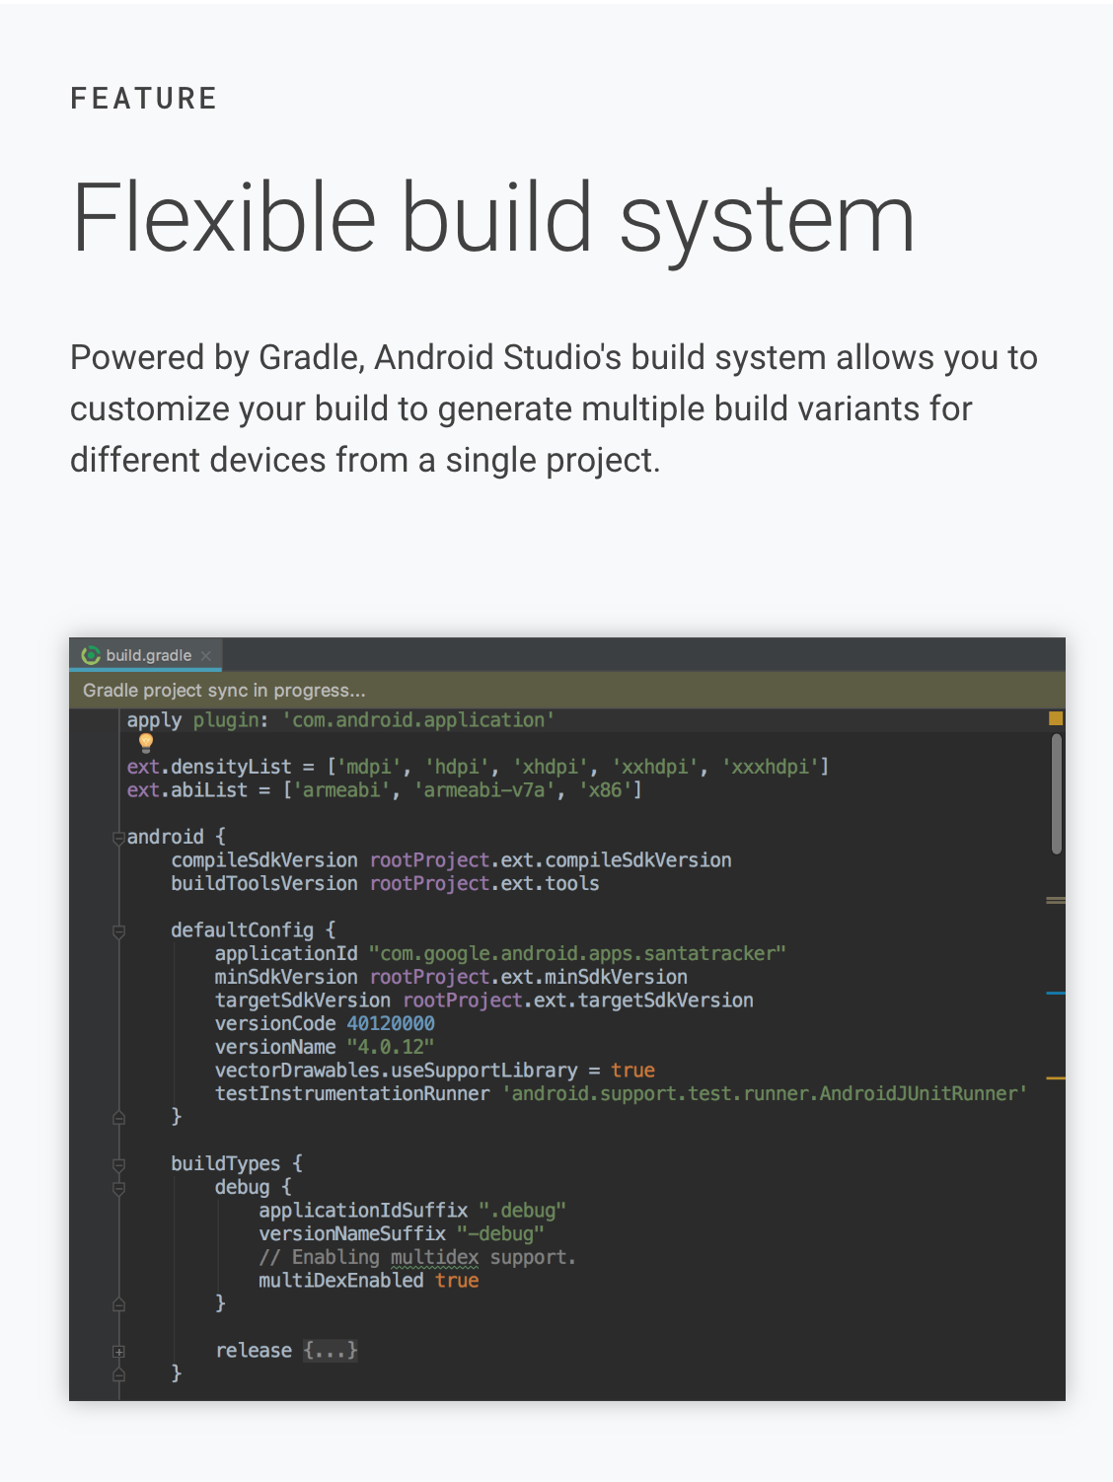

Slide 17
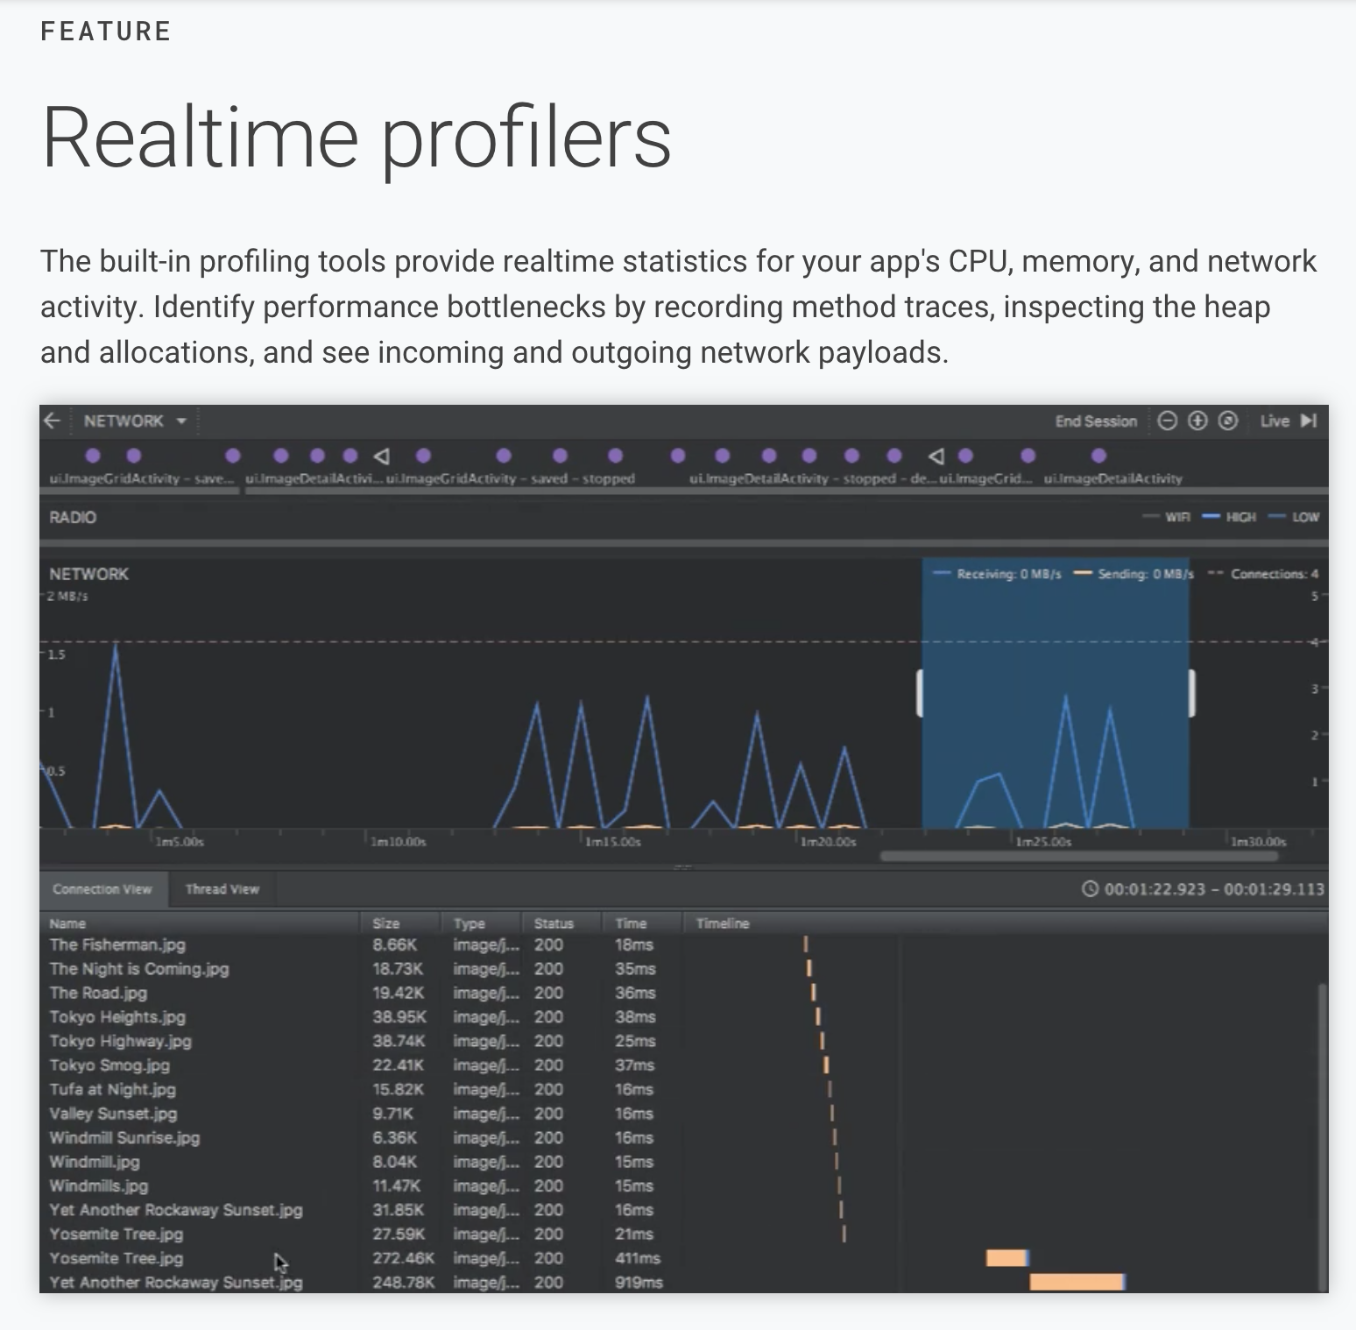

Slide 18
More:
https://developer.android.com/studio/

Slide 19
Should I learn KOTLIN?

Slide 20
More:
https://kotlinlang.org/

Slide 21
But I don’t have a device….

Slide 22
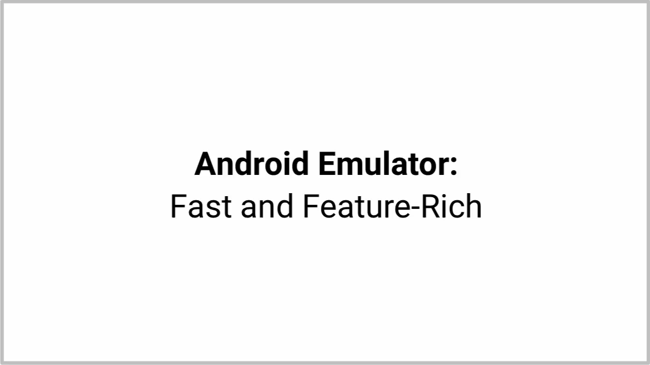

Slide 23
More:
https://developer.android.com/studio/run/emulator

Slide 24
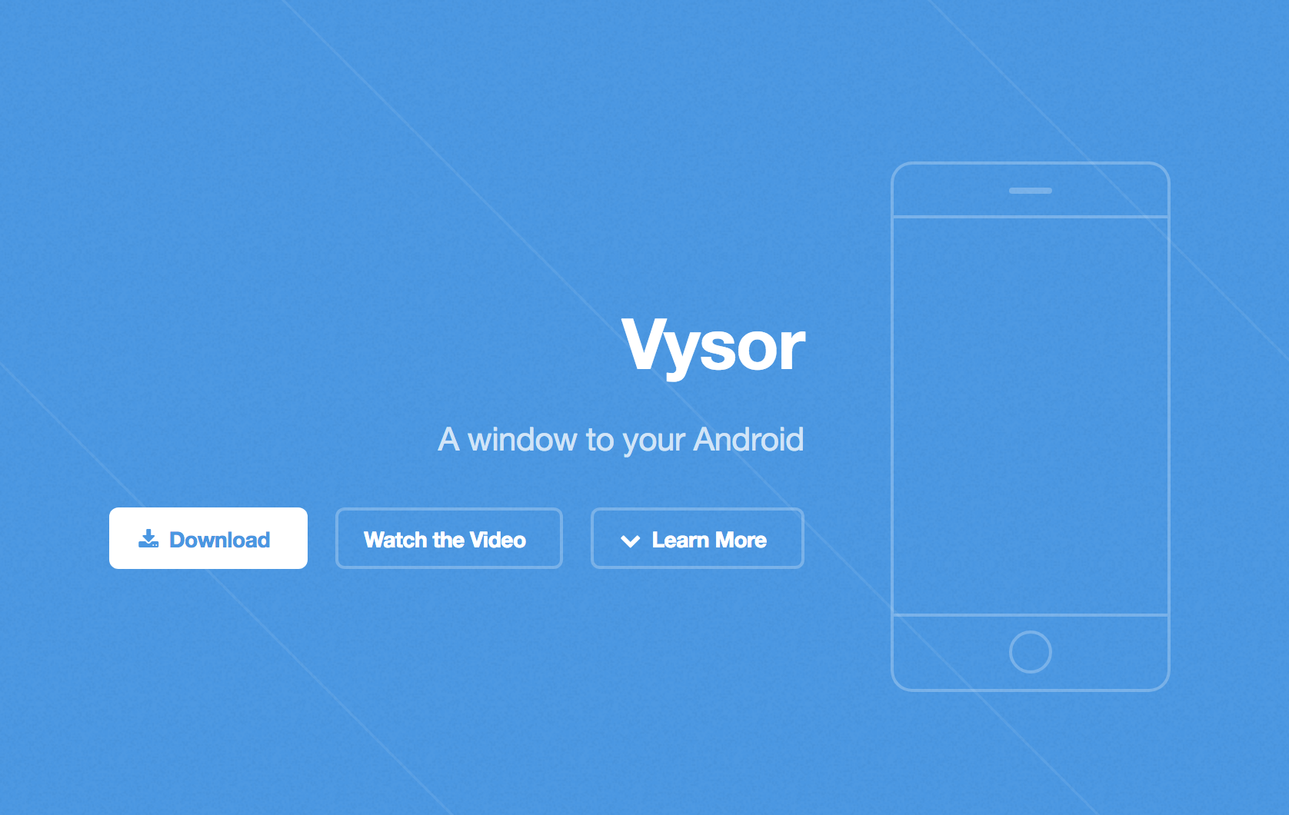
If you have a real Device:
https://www.vysor.io/

Slide 25
Android Project Structure

Slide 26
More:
https://developer.android.com/studio/projects/

Slide 27
Android Live Cycle

Slide 28
Activities
Activities are one of the fundamental building blocks of apps on the Android platform. They serve as the entry point for a user's interaction with an app, and are also central to how a user navigates within an app (as with the Back button) or between apps (as with the Recents button).

Slide 29
Activities
Skillfully managing activities allows you to ensure that, for example:
Orientation changes take place smoothly without disrupting the user experience.
User data is not lost during activity transitions.
The system kills processes when it's appropriate to do so.

Slide 30
Introduction to Activities
The Activity class is a crucial component of an Android app, and the way activities are launched and put together is a fundamental part of the platform's application model. Unlike programming paradigms in which apps are launched with a main() method, the Android system initiates code in an Activity instance by invoking specific callback methods that correspond to specific stages of its lifecycle.

Slide 31
Introduction to Activities
Most apps contain multiple screens, which means they comprise multiple activities. Typically, one activity in an app is specified as the main activity, which is the first screen to appear when the user launches the app. Each activity can then start another activity in order to perform different actions. For example, the main activity in a simple e-mail app may provide the screen that shows an e-mail inbox. From there, the main activity might launch other activities that provide screens for tasks like writing e-mails and opening individual e-mails.

Slide 32
Managing the activity lifecycle
Over the course of its lifetime, an activity goes through a number of states. You use a series of callbacks to handle transitions between states. The following sections introduce these callbacks.

Slide 33
onCreate()
You must implement this callback, which fires when the system creates your activity. Your implementation should initialize the essential components of your activity: For example, your app should create views and bind data to lists here. Most importantly, this is where you must call setContentView() to define the layout for the activity's user interface.
When onCreate() finishes, the next callback is always onStart().

Slide 34
onStart()
As onCreate() exits, the activity enters the Started state, and the activity becomes visible to the user. This callback contains what amounts to the activity’s final preparations for coming to the foreground and becoming interactive.

Slide 35
onResume()
The system invokes this callback just before the activity starts interacting with the user. At this point, the activity is at the top of the activity stack, and captures all user input. Most of an app’s core functionality is implemented in the onResume() method.
The onPause() callback always follows onResume().

Slide 36
onPause()
The system calls onPause() when the activity loses focus and enters a Paused state. This state occurs when, for example, the user taps the Back or Recents button. When the system calls onPause() for your activity, it technically means your activity is still partially visible, but most often is an indication that the user is leaving the activity, and the activity will soon enter the Stopped or Resumed state.
An activity in the Paused state may continue to update the UI if the user is expecting the UI to update. Examples of such an activity include one showing a navigation map screen or a media player playing. Even if such activities lose focus, the user expects their UI to continue updating.
You should not use onPause() to save application or user data, make network calls, or execute database transactions. For information about saving data, see Saving and restoring activity state.
Once onPause() finishes executing, the next callback is either onStop() or onResume(), depending on what happens after the activity enters the Paused state.

Slide 37
onStop()
The system calls onStop() when the activity is no longer visible to the user. This may happen because the activity is being destroyed, a new activity is starting, or an existing activity is entering a Resumed state and is covering the stopped activity. In all of these cases, the stopped activity is no longer visible at all.
The next callback that the system calls is either onRestart(), if the activity is coming back to interact with the user, or by onDestroy() if this activity is completely terminating.

Slide 38
onRestart()
The system invokes this callback when an activity in the Stopped state is about to restart. onRestart() restores the state of the activity from the time that it was stopped.
This callback is always followed by onStart().

Slide 39
onDestroy()
The system invokes this callback before an activity is destroyed.
This callback is the final one that the activity receives. onDestroy() is usually implemented to ensure that all of an activity’s resources are released when the activity, or the process containing it, is destroyed.

Slide 40
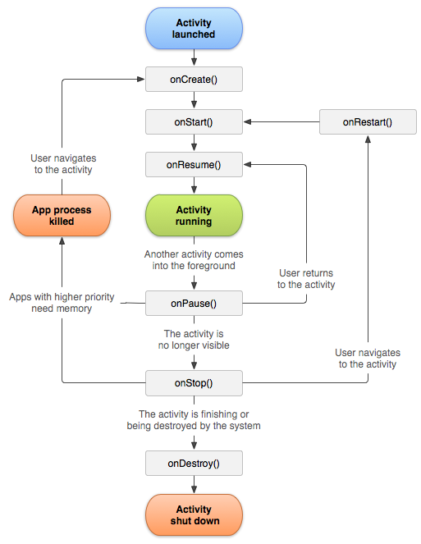

Slide 41
Depending on the complexity of your activity, you probably don't need to implement all the lifecycle methods. However, it's important that you understand each one and implement those that ensure your app behaves the way users expect.

Slide 42
Common Android Elements

Slide 43
Common Layouts

Slide 44
Linear Layout
A layout that organizes its children into a single horizontal or vertical row
Relative Layout
Enables you to specify the location of child objects relative to each other (child A to the left of child B) or to the parent (aligned to the top of the parent).
WebView
Displays web pages.
Note: Although you can nest one or more layouts within another layout to achieve your UI design, you should strive to keep your layout hierarchy as shallow as possible. Your layout draws faster if it has fewer nested layouts (a wide view hierarchy is better than a deep view hierarchy).

Slide 45
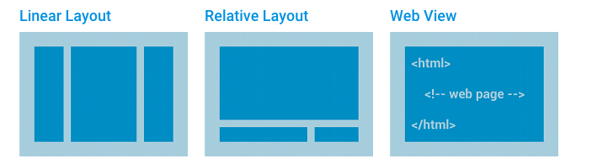

Slide 46
tutorialspoint
https://www.tutorialspoint.com/android/android_user_interface_layouts.htm

Slide 47
relative measurements

Slide 48
density-independent pixel units (dp)
scale-independent pixels (sp)
wrap_content tells your view to size itself to the dimensions required by its content.
match_parent tells your view to become as big as its parent view group will allow.

Slide 49
density-independent pixel units (dp)
dp or dip
Density-independent Pixels - an abstract unit that is based on the physical density of the screen. These units are relative to a 160 dpi screen, so one dp is one pixel on a 160 dpi screen. The ratio of dp-to-pixel will change with the screen density, but not necessarily in direct proportion. Note: The compiler accepts both "dip" and "dp", though "dp" is more consistent with "sp".

Slide 50
Scale-independent Pixels (SP)
Scale-independent Pixels - this is like the dp unit, but it is also scaled by the user's font size preference. It is recommended you use this unit when specifying font sizes, so they will be adjusted for both the screen density and user's preference.

Slide 51
Elements

Slide 52
UI Control & Description
TextView
This control is used to display text to the user.
EditText
EditText is a predefined subclass of TextView that includes rich editing capabilities.
Button
A push-button that can be pressed, or clicked, by the user to perform an action.
ImageButton
An ImageButton is an AbsoluteLayout which enables you to specify the exact location of its children. This shows a button with an image (instead of text) that can be pressed or clicked by the user.

Slide 53
UI Control & Description
CheckBox
An on/off switch that can be toggled by the user. You should use check box when presenting users with a group of selectable options that are not mutually exclusive.
ToggleButton
An on/off button with a light indicator.
RadioButton
The RadioButton has two states: either checked or unchecked.
RadioGroup
A RadioGroup is used to group together one or more RadioButtons.

Slide 54
UI Control & Description
ProgressBar
The ProgressBar view provides visual feedback about some ongoing tasks, such as when you are performing a task in the background.
Spinner
A drop-down list that allows users to select one value from a set.
TimePicker
The TimePicker view enables users to select a time of the day, in either 24-hour mode or AM/PM mode.
DatePicker
The DatePicker view enables users to select a date of the day.
AutoCompleteTextView
The AutoCompleteTextView is a view that is similar to EditText, except that it shows a list of completion suggestions automatically while the user is typing.

Slide 55
tutorialspoint
https://www.tutorialspoint.com/android/android_user_interface_controls.htm

Slide 56
ScrollView
When an app has layout content that might be longer than the height of the device and that content should be vertically scrollable, then we need to use a ScrollView.
Note that a ScrollView can only contain a single child element so if you need multiple things to be scrollable, you need to wrap that content into a layout as shown above.
https://guides.codepath.com/android/Working-with-the-ScrollView

Slide 57
Re-using Layouts with <include/>
Reusing layouts is particularly powerful as it allows you create reusable complex layouts. For example, a yes/no button panel, or custom progress bar with description text. It also means that any elements of your application that are common across multiple layouts can be extracted, managed separately, then included in each layout. So while you can create individual UI components by writing a custom View, you can do it even more easily by re-using a layout file.
https://developer.android.com/training/improving-layouts/reusing-layouts.html#Include

Slide 58
More:
https://www.tutorialspoint.com/android/android_user_interface_layouts.htm

Slide 59
Demo

Slide 60
Homework:
Download Android Studio
Setup Emulator
Create a new blank application version 4.4
Change version of Application to 1.1
Change application name
Add 2 new strings to strings values
Build & Run in emulator

Slide 61
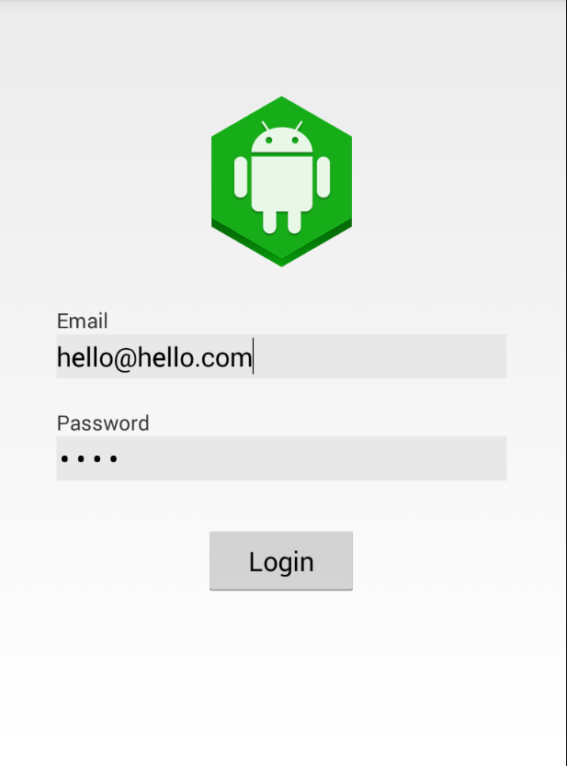
Homework
Password field should be secure input
All should look good on a small screen (240x320)
All strings from a resource file
All colors from a resource file
Change color of background on Application entering background

